Slide 1
Software Process
Dan Pei, Dan Li
Department of Computer Science and Technology
Tsinghua University, Beijing, China
Notes:
本次讲两个topic: 过程和项目管理。软件工程最重要的是人的因素
人：软件工程与其它工程的区别
谈谈自己对软件开发过程的理解： 与3天写个大作业有什么不同？你体会到了什么？
从用户的要求考虑 vs。 从完成作业的要求角度考虑
合作 vs. 各干各的
过程 vs. 最后的结果。工具使用更熟练了。
慢慢写 vs. 突击写。 写得更从容，逻辑更清楚，少出错。
现在我们在回顾一下历史。

Slide 2
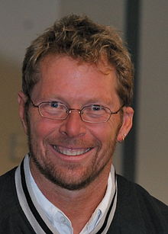
Software Engineering
Software Development is resource-limited cooperative game of
invention and communication
Alistair Cockburn One of the initiators of the agile movement
Doing Engineering is creating a trade-off solution in the face of conflicting demands.
Notes:
Alistair Cockburn /ˈælɪstər ˈkoʊbərn/ (born November 19, 1963) is an American computer scientist, known as one of the initiators of the agile movement in software development. He signed the Manifesto for Agile Software Development ^{[1]}

Slide 3
A Layered Technology
Tools
Methods
Process
Quality Focus
Notes:
这四层紧密相关， 虽然这一讲主要讲process, 但是是以质量为目的，并涉及process所需要的方法和工具

Slide 4

The Process Premise
“The quality of a software system is governed by the quality of the process used to develop and evolve it.”
-- Watts Humphrey
“Father of software quality”
Founder of Software Engineering Institute at CMU, which developed Capability Maturity Model
Notes:
Watts S. Humphrey (July 4, 1927 – October 28, 2010) was an American pioneer in software engineering who was called the "father of software quality."^{[1]}
Watts: CMU 90s: decade of software process.
80s: decade of OO
日本强调工业生产的过程管理

Slide 5

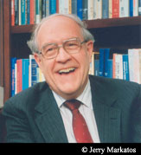
When software development process was ad hoc…
“软件人员太像皇帝新衣故事中的裁缝了。当我来检查软件开发工作时，所得到的回答好象对我说：我们正忙于编织这件带有魔法的织物。只要等一会儿，你就会看到这件织物是及其美丽的。
但是我什么也看不到，什么也摸不到，也说不出任何一个有关的数字，没有任何办法得到一些信息说明事情确实进行得非常顺利，而且我已经知道许多人最终已经编织了一大堆昂贵的废物而离去，还有不少人最终什么也没有做出来。”
-- F.D. Brooks, Manager of OS/360
“The Mythical Man-Month”, 1974
Notes:
图灵奖得主 后来去大学教书。
OS/360, officially known as IBM System/360 Operating System,^{[1][2]} is a discontinued batch processingoperating system developed by IBM for their then-new System/360 mainframe computer, announced in 1964
复杂性、一致性、可变性、不可见性、
这四个难题处理不好，就会导致。。。。
Complexity
Conformity
Changeability
Invisibility

Slide 6
…although the developers were very diligent.
“…没有别的场景比巨兽在焦油坑中垂死挣扎的场面更令人震撼…它们挣扎得越是猛烈，焦油纠缠得越紧，没有任何猛兽足够强壮或具有足够的技巧，能够挣脱束缚，它们最后都沉到了坑底。
过去几十年的大型系统开发就犹如这样一个焦油坑，很多大型和强壮的动物在其中剧烈地挣扎…各种团队 ，大型的和小型的，庞杂的和精干的，一个接一个淹没在了焦油坑中…”
-- F.D. Brooks, Manager of OS/360
“The Mythical Man-Month”, 1974
Brooks' project, OS/360:
was late (over 5000 person year, 61-64)
cost many times more than estimate (over $500M)

Slide 7
Software Process Spectrum
Waterfall
Incremental
Prototyping
Spiral
Process Models
Light-weight Process
Agile
CMM
SPICE
Ad Hoc development
Heavy-weight Process

Slide 8
~1968: bring engineering discipline to software
Why can’t building software be like building a bridge? Safe, predictable cost & quality…
(though 90% infrastructure projects late/over $)
“Plan-and-Document”
Before coding, project manager makes plan
Write detailed documentation all phases of plan
Progress measured against the plan
Changes to project must be reflected in documentation and possibly to plan
© 2013 -2017 Armando Fox & David Patterson, all rights reserved Berkeley CS 169 Slides

Slide 9

1st Development Process: Waterfall (1970), 5 phases
Requirement
Design
Requirements analysis & specification
Architectural design
Implementation & Integration
Verification
Operation & Maintenance
Complete one phase before start next one
Why? Earlier catch bug, cheaper it is
Extensive documentation/phase for new people
Coding
Testing
Maintenance
© 2013 -2017 Armando Fox & David Patterson, all rights reserved. Berkeley CS 169 Slides
Notes:
Like falling down a waterfall
Lots of planning,
6-12 months or more per step
Often steps done by different people
Throw over the wall
Lots of documentataion in case people leave

Slide 10
Was this a successful approach for SW development?
~420KLOC, ≤1 bug in last 3 versions
260 SW engineers working for one of only 4 dev shops to receive highest “maturity rating” from SW Engineering Institute@CMU
Rigorous adherence to waterfall
ex: 6 KLoC change = 2500 pages of docs
They Write the Right Stuff. FastCompany, 1996. Photo: Flickr user Matthew Simantov, CC-BY-SA
© 2013 -2017 Armando Fox & David Patterson, all rights reserved Berkeley CS 169 Slides

Slide 11
Was this a successful approach for SW development?
And the users exclaimed with a laugh and a taunt: “It’s just what we asked for, but not what we want.” —Anonymous
Software’s strength is its evolvability— its ability to change and adapt— but that’s a poor fit for Waterfall approaches
Lengthy @ each step, bounced back to earlier steps when problems are encountered.
Requirement
Design
Coding
Testing
Maintenance
© 2013 -2017 Armando Fox & David Patterson, all rights reserved Berkeley CS 169 Slides
Notes:
大声嘲笑

Slide 12
How Well do Plan-and-Document Processes Work?
IEEE Spectrum “Software Wall of Shame”
31 projects: lost $17B
250
3X
1027
3 out of ~500 new development projects on time and budget
(from Engineering Software as a Service by Armando Fox and David Patterson, used with permission)
© 2013 -2017 Armando Fox & David Patterson, all rights reserved Berkeley CS 169 Slides
Notes:
Figure 1.6: The first study of software projects found that 53% of projects exceeding their budgets by a factor of 2.9 and overshot their schedule by a factor of 3.2 and another 31% of software projects were cancelled before completion (Johnson 1995).
The an estimated annual cost in the United States for such software projects was $100B. The second survey of 250 large projects, each with the equivalent of more than a million lines of C code, found similarly disappointing results (Jones 2004).
The final survey of members of the British Computer Society found that only 130 of 1027 projects met their schedule and budget. Half of all projects were maintenance or data conversion projects and half new development project, but the successful projects divided into 127 of the former and just 3 of the latter (Taylor 2000).

Slide 13
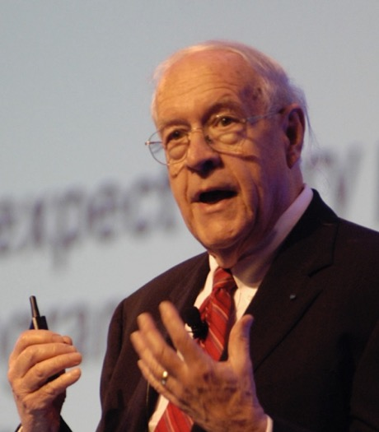
How to deal with change?
Software customers and end-users usually find it very difficult to express their real requirements.
Hard to predicate how a system will affect working practices
“Plan to throw one [implementation] away; you will, anyhow.”
Fred Brooks, Jr. (1999 Turing Award winner)
Often after build first one, developers learn right way they should have built it
(Photo by Carola Lauber of SD&M www.sdm.de. Used by permission under CC-BY-SA-3.0.)
© 2013 -2017 Armando Fox & David Patterson, all rights reserved Berkeley CS 169 Slides
Notes:
May apply to your project
Downside to waterfall?

Slide 14
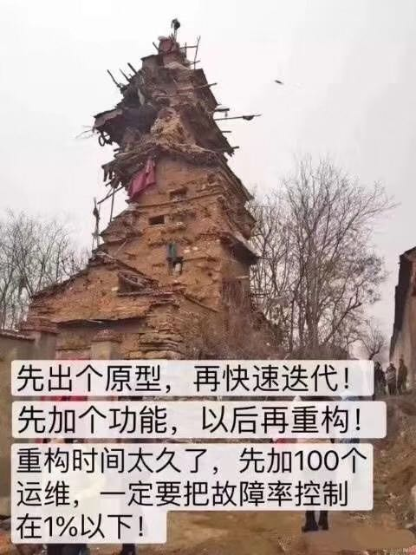
Evolutionary Process Model – Prototyping
Can we build software effectively without careful planning and documentation?
Evolutionary Process Model: Enable software engineers to develop increasingly, iteratively more complete versions of the software
Prototyping as the methods for requirement analysis
Throw-away prototyping
Evolutionary prototyping
How to avoid “just hacking”?
Notes:
How to avoid “just hacking”?
Throw-away prototyping
A prototype which is usually a practical implementation of the system is produced to help discover requirements problems and then discarded. The system is then developed using some other development process
Evolutionary prototyping
An approach to system development where an initial prototype is produced and refined through a number of stages to the final system

Slide 15
Agile Manifesto
“We are uncovering better ways of developing software by doing it and helping others do it. Through this work we have come to value:
Individual and interactions over processes and tools
Working software over comprehensive documentation
Customer collaboration over contract negotiation
Responding to change over following a plan
That is, while there is value in the items on the right, we value the items on the left more. ”
“Manifesto for Agile Software Development”,
K. Beck, et al., 2001.
Notes:
Beck, Part of Small Talk team, led by Allen Key
相对于。。。 我们更看重。。。
中间过程要可见： 不是通过文档可见， 而是通过可用软件可见。

Slide 16
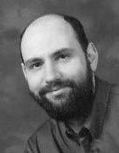
“The New Methodology” by Martin Fowler
Adaptive rather than predictive
Heavy methods tend to try to plan out a large part of the software process in great detail for a long span of time, this works well until things change. So their nature is to resist change.
The light methods, however, welcome change. They try to be processes that adapt and thrive on change, even to the point of changing themselves.
People-oriented rather than process-oriented
They explicitly make a point of trying to work with peoples' nature rather than against them and to emphasize that software development should be an enjoyable activity.
Agile Pioneer,
Author of ”Refactoring”
Book
Notes:
符合人性，而不是反人性

Slide 17
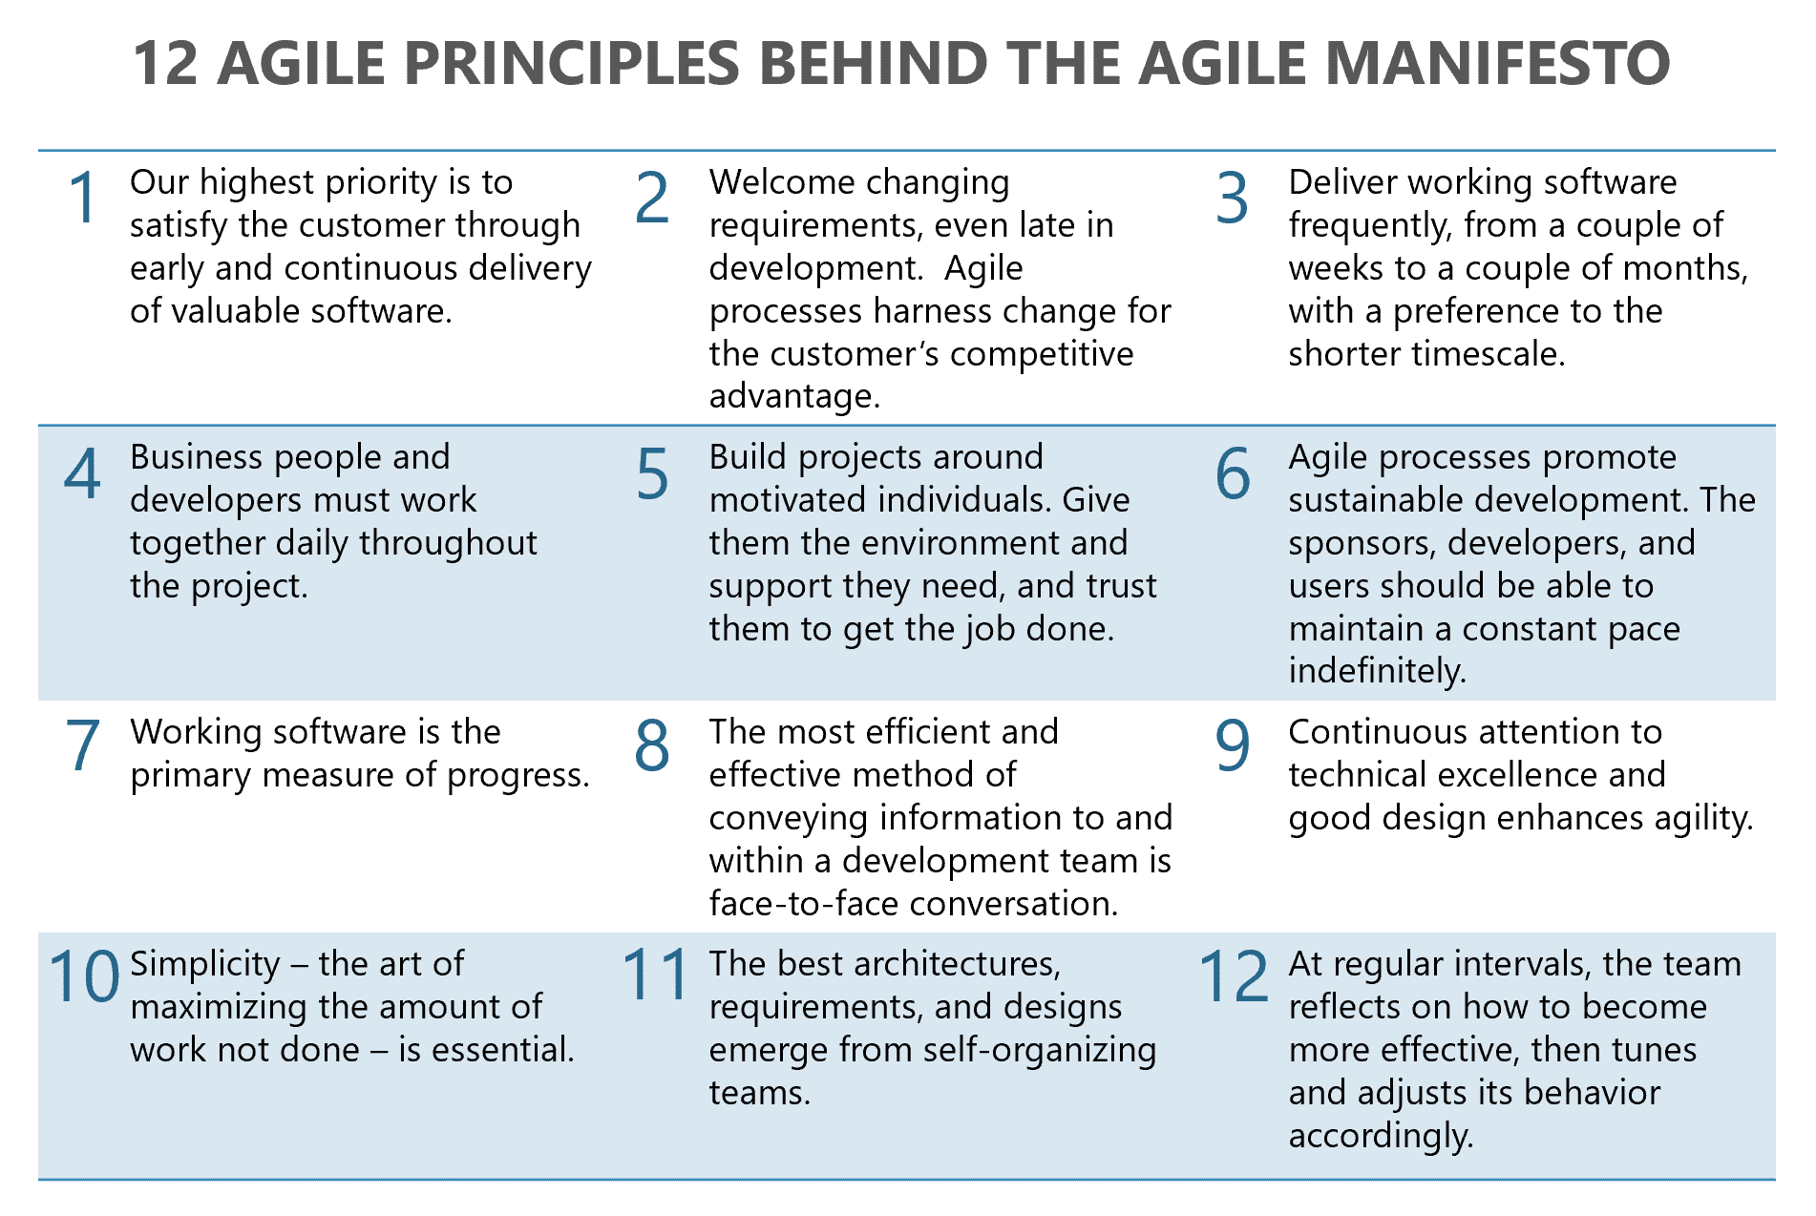

Slide 18
A Layered Technology
Tools
Methods
Process
Quality Focus
Notes:
这四层紧密相关， 虽然这一讲主要讲process, 但是是以质量为目的，并涉及process所需要的方法和工具

Slide 19
Agile Methods
Agile methods:
Scrum
Extreme Programming
Adaptive Software Development (ASD)
Dynamic System Development Method (DSDM)
…
Agile Alliance
A non-profit organization promotes agile development

Slide 20

Agile with Scrum Process
In rugby, the term “scrum” refers to a method of restarting play where teams interlock arms, lower their heads, and push against the other team in order to gain possession of the ball.
The idea of a scrum is teamwork. All players are interlocked and move together as a team toward the same goal. No individual player stands alone.
Notes:
我们讲CI是从代码出发的。
在代码之外，我们还有过程，从idea变成产品的过程。这也是整个layered technology 那幅图最下面那个： process
SCRUM is an agile, lightweight process for managing and controlling software and product development in rapidly changing environments.
Iterative, incremental process
Team-based approach
developing systems/ products with rapidly changing requirements
Controls the chaos of conflicting interest and needs
Improve communication and maximize cooperation
Protecting the team from disruptions and impediments
A way to maximize productivity

Slide 21
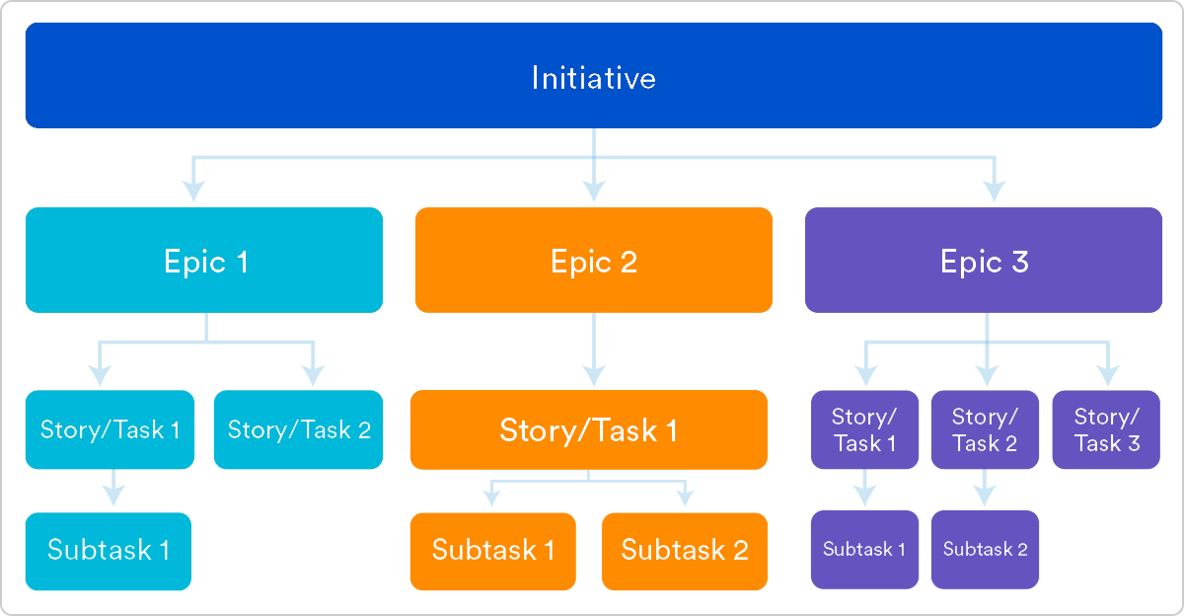
Initiatives, Epics, and Stories
Stories, also called “user stories,” are short requirements or requests written from the perspective of an end user. Completed within one or two-week sprint.
An epic is a large body of work that can be broken down into a number of smaller stories. Epics are almost always delivered over a set of sprints, within a month or a quarter. 2-3 epics per quarter. Scope are flexible: Its user stories can be added/removed.
Initiatives are collections of epics that drive toward a common goal. Completed in multiple quarters to year

Slide 22


用户故事表达：卡片
验收标准
作为一名消费者（<角色>）
每10秒钟读取DecaWatt计量表的数据，在门户上显示15分钟的增量，在室内屏上显示每一读数；
随着新数据的产生读取KiloWatt计量表，并且每小时显示在门户上，在每次读取后显示在室内屏上；
……
作为一名 <角色>，
我可以 <活动>，
使得 <业务价值>。
我希望能够查看我的日常
能源使用量（<我利用系统
做什么>），从而我可以
降低能源支出和使用率
（<我收到的业务价值>）。
Notes:
用户故事： 一定要体现对客户的价值。
用户、活动、价值
反过来说， 如果有个功能，不能表达出对用户的清晰的价值，那么开发人员要仔细想想这个功能是不是值得做。

Slide 23
良好的用户故事 INVEST
Independent 独立性
Negotiable 可协商
Valuable 有价值
Estimable 可估算
Testable 可测试
Small 小型
故事不依赖于其它故事，可以被单独地开发、测试甚至交付。
故事不是详尽的需求说明书（系统应该完成的事），而是可协商的意向表达。
聚焦与由用户规定的价值，而非功能分解结构
故事相对而言更容易估算，可以快速确定实现相关功能的工作量。
故事代表有价值功能的小型增量，可以在一到两周内交付。
清晰可测试
Notes:
独立的功能要拆成两个；不独立的要合并。
不再是契约而是可协商、需要探索的。
小型： 迭代周期一到两周；每天1到两天每个功能点。
本次开发完成不了的，放到product backlog 里。

Slide 24
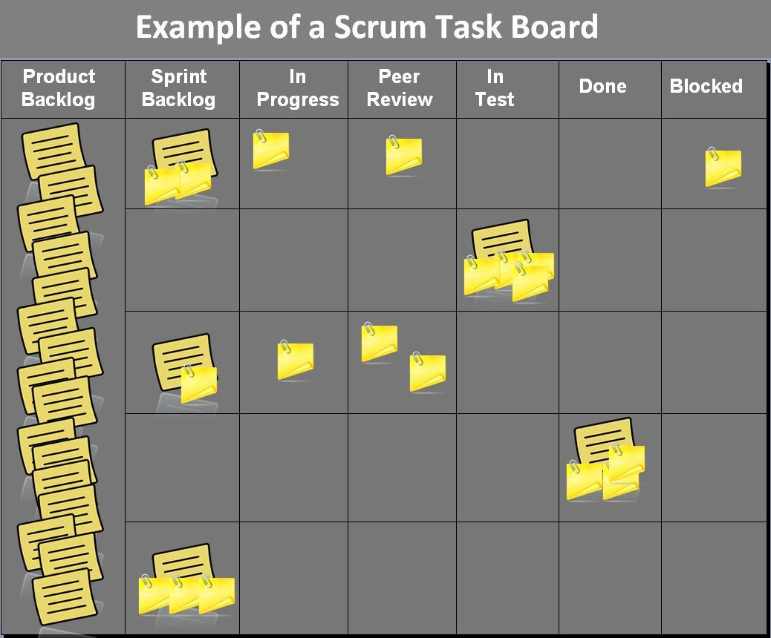
Product Backlogs:
User Stories
Technical Stories
Spikes
Experimental Stories
Defects
Notes:
Spikes are an invention of Extreme Programming (XP), are a special type of user story that is used to gain the knowledge necessary to reduce the risk of a technical approach, better understand a requirement, or increase the reliability of a story estimate. A spike has a maximum time-box size as the sprint it is contained in it. At the end of a sprint, the spike will be determined that is done or not-done just like any other ordinary user story. A Spike is a great way to mitigate risks early and allows the team ascertain feedback and develop an understanding on an upcoming PBI’s complexity.
When To Use Spike?
Sometime the team unsure if they can complete the story due to some potential blockers and probably can’t even estimate the story. Thus, you may consider a spike as an investment for a Product Owner to figure out what needs to be built and how the team is going to build it. The Product Owner allocates a little bit of the team’s capacity now, ahead of when the story needs to be delivered, so that when the story comes into the sprint, the team knows what to do.
Here are the examples of when Spikes may be used:
The team may not have knowledge of a new technology, and spikes may be used for basic research to ensure the feasibility of the new technology (domain or new approach).
A story requires to be implemented using a 3rd party library with API that is poorly written and documented.
The story may contain significant technical risk, and the team may have to do some experiments or prototypes to gain confidence in a technological approach that may allow them to commit the user story to some future timebox.

Slide 25
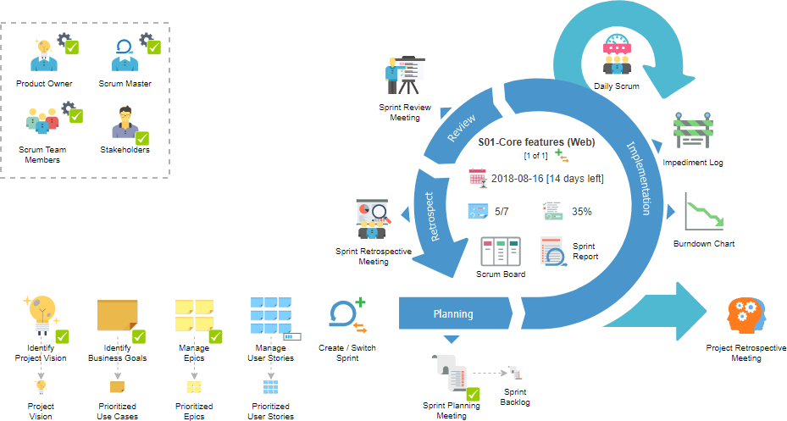
Notes:
backlog: 积压的工作，待办列表
Product Owner who represents the stakeholders
Ensure that the Scrum Team works with the right things from a business perspective
Scrum Master who maintains the processes and works similar to a project manager
Scrum Team which includes the developers
Self-organized and the members have joint responsibility for the results
Sprint Planning:
Individuals sign up for work of their own choosing
Estimated work remaining is updated daily
Any team member can add, delete or change the sprint backlog
Work for the sprint emerges
If work is unclear, define a sprint backlog item with a larger amount of time and break it down later
Update work remaining as more becomes unknown
Daily Scrum Meeting:
Total 15minutes/day
What have you done yesterday
What you plan to do today
What’s the obascle.
Sprint Review
Show off completed functionality
Sprint Retrospective
What went well during the Sprint?
What could be improved for the next?
scrum 敏捷过程主要体现在如下几个方面：
线下沟通合作。
频繁迭代的过程
3. 小迭代的计划：Backlog： 本次迭代sprint的功能的列表. 小的迭代的集合构成一个backlog. sprint 结束的时候要用demo 来验证backlog的完成情况。
3. daily scrum meeting.
结合项目计划书来进行。
通过小迭代轻量级有控制的过程在自由与秩序中找到平衡，对质量好好控制。
Impediment: 阻碍

Slide 26
Tools for Agile Development
Tools
Methods
Process
Quality Focus
Notes:
这四层紧密相关， 虽然这一讲主要讲process, 但是是以质量为目的，并涉及process所需要的方法和工具

Slide 27
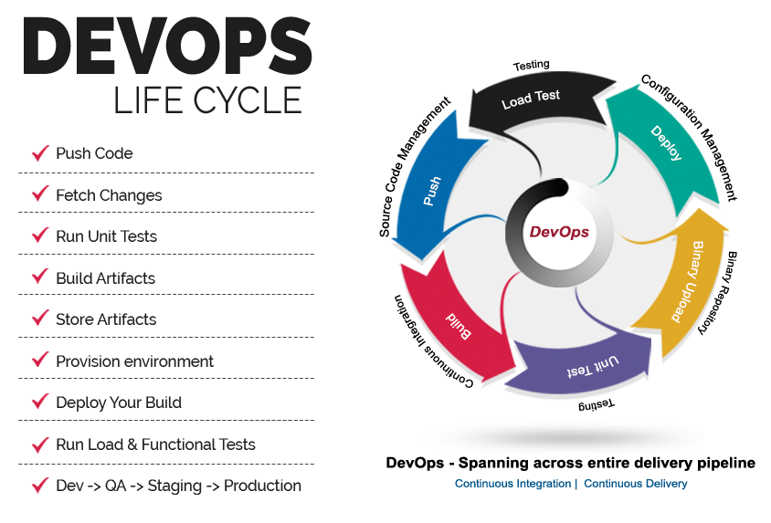
DevOps (Development + Operations)
Software
Develop-
ment
Quality
Assurance
Technology
Operations
Notes:
Collaborative Development
Foster productive collaboration with deeper lifecycle integrations
“No hassle” collaborative development capabilities on the cloud for continuous delivery
Continuous Testing
Enhance integrations and capabilities to synchronize software testing with deployment and operations
Continuous Release and Deployment
Greater delivery speed and frequency for complex applications
Continuous Monitoring
Capabilities to improve service quality by monitoring application performance
The New Era of Integrated Software Delivery with DevOps, S. Perepa, IBM.
https://resources.sei.cmu.edu/asset_files/Presentation/2014_017_101_90315.pdf

Slide 28



Build
Allow multiple integrations per day
Each integration is automatically built (tested, integrated) to generate a immediately deployable system
Code
Repository
Artifact
Repository
Test
Analysis
Deployment
Report
Notes:
“Continuous Integration is a software development practice where members of a team integrate their work frequently, usually each person integrates at least daily – leading to multiple integrations per day. Each integration is verified by an automated build (including test) to detect integration errors as quickly as possible” – Martin Fowler
Immediate bug detection
Immediate integration
Immediate deployable system

Slide 29
GitLab Task Management

Slide 30
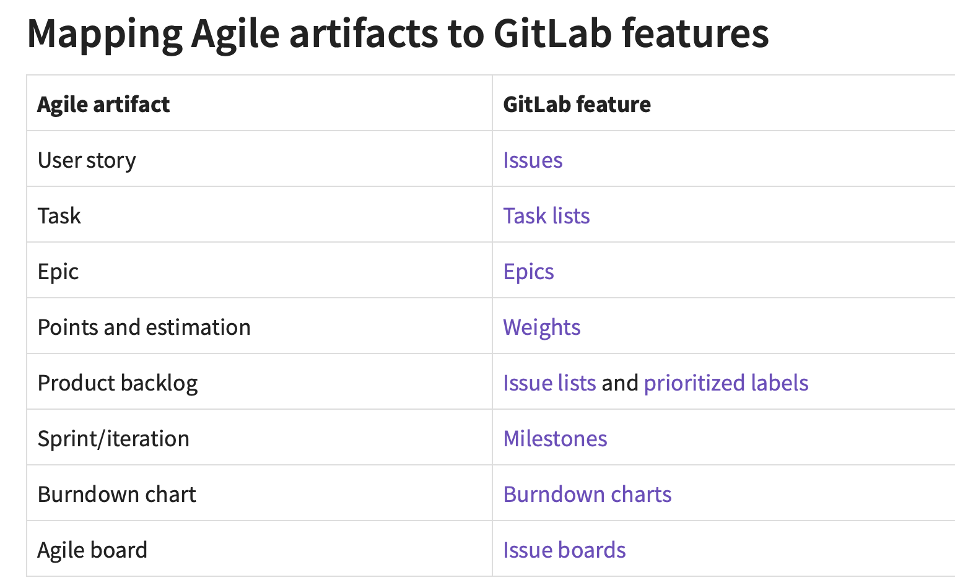
https://about.gitlab.com/blog/2018/03/05/gitlab-for-agile-software-development/
Notes:
When you have a lot of issues, it can be hard to get an overview. By adding a weight to each issue, you can get a better idea of how much time, value or complexity a given issue has or will cost.
Also in this meeting, user stories are communicated, and the level of technical effort is estimated for each in-scope user story. In GitLab, issues have a weight attribute, which you would use to indicate the estimated effort.

Slide 31
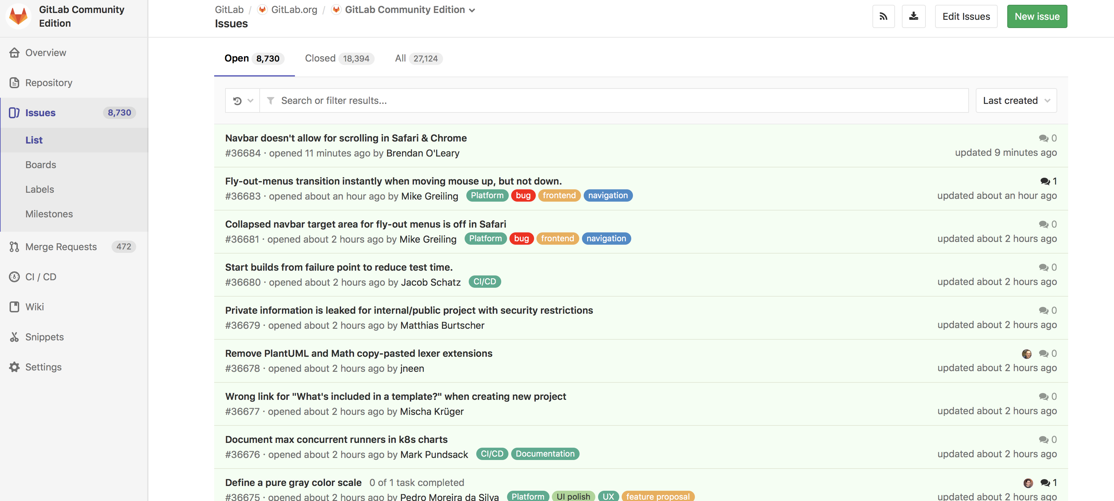
Issues (User Stories)
Labels：
Visualize
Navigate
Filter
Prioritize
Notes:
Labels provide an easy way to categorize the issues or merge requests based on descriptive titles.
Visualize
Navigate
Filter
Prioritize

Slide 32
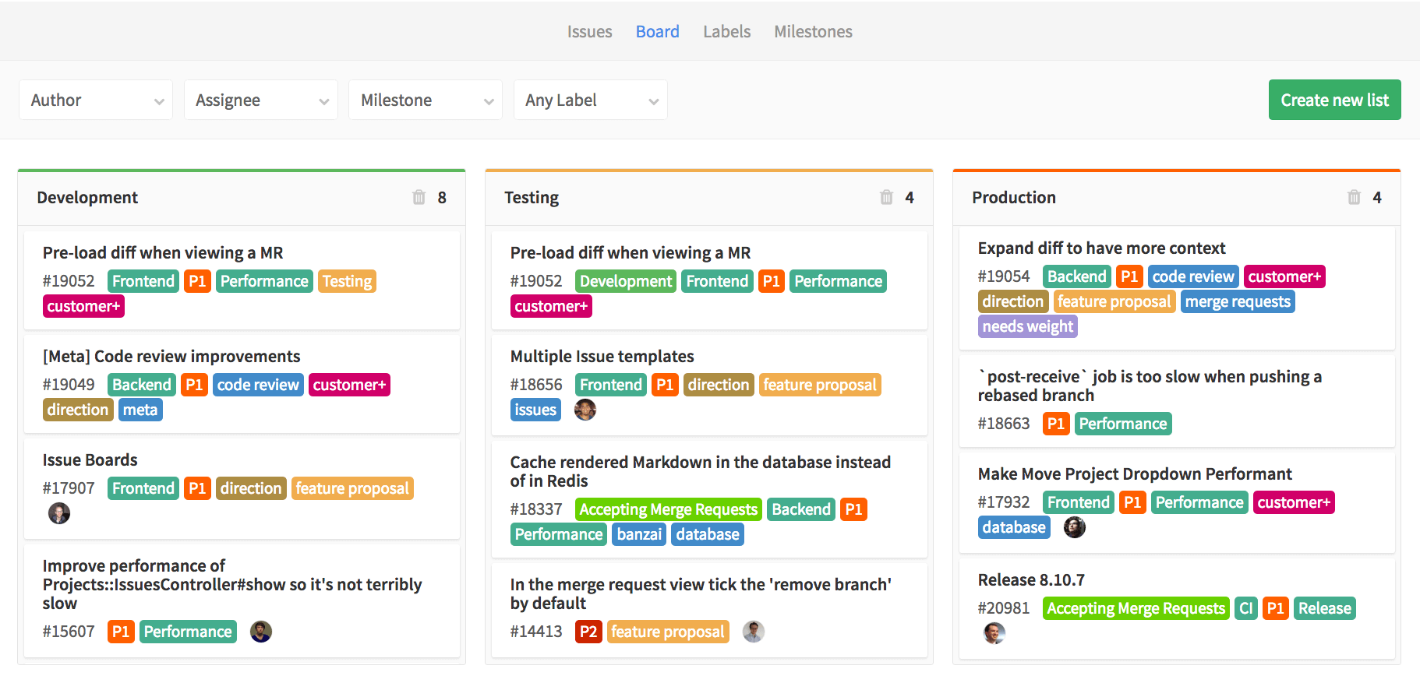
Issue Board (Agile Board)
Notes:
Manage issues
Cards of issue lists, representing each stage in development process
Project management tool used to plan, organize, and visualize a team’s feature or product release process
Default and user-defined label lists (cards)
Default “backlog”: all open issues that does not belong to one of the lists.
Default “closed”: all closed issues
User-defined label lists: each card shows a list of open issues with the label.

Slide 33
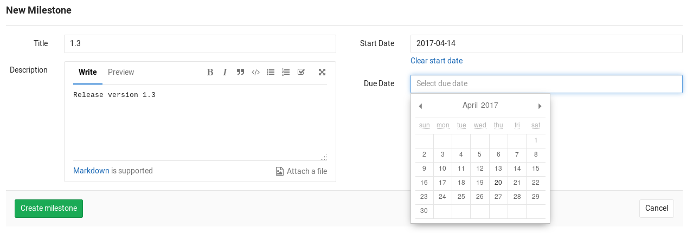
Milestone (Sprint)
Set a deadline for certain tasks (issues and merge requests) to achieve a staged goal.
Track progress
Track an upcoming software version
Track the launch of a new product
Track the progress of achievements per quarter for your team
Track the community contributions for a new feature in your open source application

Slide 34
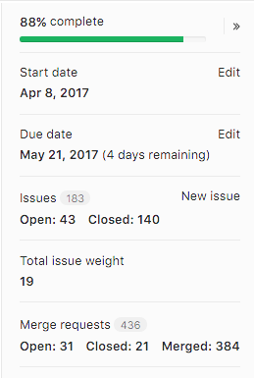
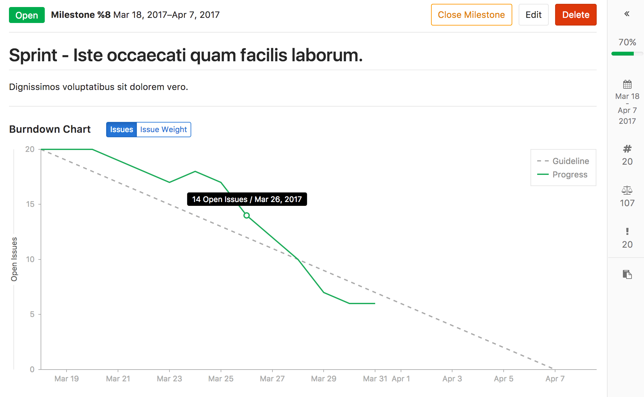
Burndown chart

Slide 35
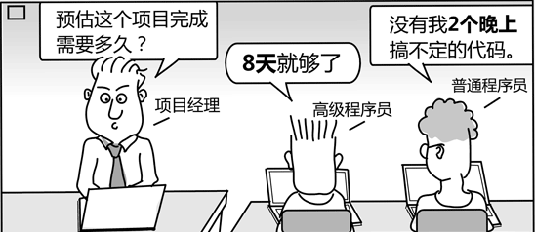
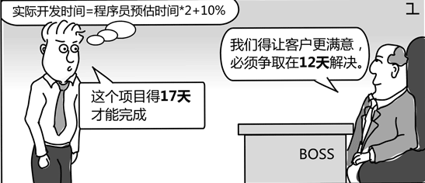
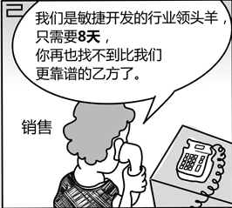
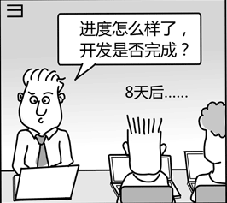
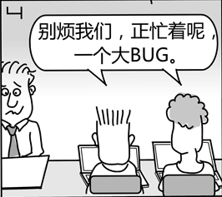
Notes:
do you have someone like this around you?

Slide 36

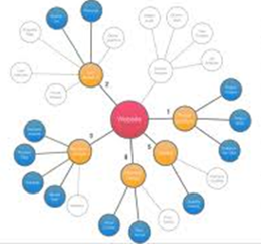

Scheduling: Tasks vs Resources
Question:
“How does a project get to be a year late?”
Answer:
“One day at a time.”
Tasks
Resources
Notes:
与work breakdown 对应的还有各个任务的时间。
大作业怎么没做完？一天一天晚下来的。每一个issue晚一天。
执行力很重要。

Slide 37
Scheduling in Agile Process
Not to worry about critical path within an iteration, because of the daily standups.
Rolling lookahead planning: teams (on projects with multiple teams) conclude their sprint planning meetings by taking a five minute look ahead at the next 1-3 iterations, identifying dependencies between teams.
On a very complex project:
Try first to write mostly independent product backlog items. If a project's product backlog items are independent and can be developed in any sequence then critical path issues disappear.
Drawing a task network diagram to see the relationships among the next 3-6 months worth of user stories, and conduct critical path analysis

Slide 38
Task Network Diagram
Also called an activity network
Depicts project task length, sequence, concurrency, and dependency
Critical path is the longest-duration path through the network.
The activities lie on it cannot be delayed without delaying the project.
To accelerate the project, it is necessary to reduce the total time required for the activities in the critical path.
Task B
6
Task C
8
Task I
8
Task J
6
Task D
6
Task A
2
Task E
7
Task H
2
Task M
5
Task F
8
Task G
8
Task K
9
Task L
7
Critical Path: A-B-C-D-H-K-L-M
Notes:
大家算一算？最长路径就是关键路径。

Slide 39
CLASS EXERCISE
Timeline chart:
4/1 4/8 4/15 4/22 4/29 5/6 5/13 5/20 5/27
Task #
Task Name
Duration
Start
Finish
Pred.
A
Establish increments
3
4/1
None
B
Analyze Inc One
3
A
C
Design Inc One
8
B
D
Code Inc One
7
C
E
Test Inc One
10
D
F
Install Inc One
5
E
G
Analyze Inc Two
7
A, B
H
Design Inc Two
5
G
I
Code Inc Two
4
H
J
Test Inc Two
6
E, I
K
Install Inc Two
2
J
L
Close out project
2
F, K

Slide 40
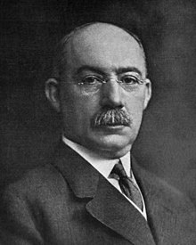
SOLUTION
Timeline chart:
4/1 4/8 4/15 4/22 4/29 5/6 5/13 5/20 5/27 6/3
Task #
Task Name
Duration
Start
Finish
Pred.
A
Establish increments
3
4/1
4/3
None
B
Analyze Inc One
3
4/4
4/6
A
C
Design Inc One
8
4/7
4/14
B
D
Code Inc One
7
4/15
4/21
C
E
Test Inc One
10
4/22
5/1
D
F
Install Inc One
5
5/2
5/6
E
G
Analyze Inc Two
7
4/7
4/13
A, B
H
Design Inc Two
5
4/14
4/18
G
I
Code Inc Two
4
4/19
4/22
H
J
Test Inc Two
6
5/2
5/7
E, I
K
Install Inc Two
2
5/8
5/9
J
L
Close out project
2
5/10
5/11
F, K
Henry Gantt, (1861-1919)
inventor of the Gantt chart
B. Analyze
Inc One
3
C. Design
Inc One
8
D. Code
Inc One
7
E. Test
Inc One
10
F. Install
Inc One
5
A. Establish
Increments
3
L. Close out
Project
2
G. Analyze
Inc Two
7
H. Design
Inc Two
5
I. Code
Inc Two
4
J. Test
Inc Two
6
K. Install
Inc Two
2
Notes:
一个大的系统中，真实的项目
你们某个大作业定了600个issue. 几乎不可能提前预估好600个issue。
三个维度：人、任务、时间。这边表把人去掉了。
Task network and the critical path: A-B-C-D-E-J-K-L

Slide 41
SOLUTION
Timeline chart:
4/1 4/8 4/15 4/22 4/29 5/6 5/13 5/20 5/27 6/3
Task #
Task Name
Duration
Start
Finish
Pred.
A
Establish increments
3
4/1
4/3
None
B
Analyze Inc One
3
4/4
4/6
A
C
Design Inc One
8
4/7
4/14
B
D
Code Inc One
7
4/15
4/21
C
E
Test Inc One
10
4/22
5/1
D
F
Install Inc One
5
5/2
5/6
E
G
Analyze Inc Two
7
4/7
4/13
A, B
H
Design Inc Two
5
4/14
4/18
G
I
Code Inc Two
4
4/19
4/22
H
J
Test Inc Two
6
5/2
5/7
E, I
K
Install Inc Two
2
5/8
5/9
J
L
Close out project
2
5/10
5/11
F, K
Henry Gantt, (1861-1919)
inventor of the Gantt chart
B. Analyze
Inc One
3
C. Design
Inc One
8
D. Code
Inc One
7
E. Test
Inc One
10
F. Install
Inc One
5
A. Establish
Increments
3
L. Close out
Project
2
G. Analyze
Inc Two
7
H. Design
Inc Two
5
I. Code
Inc Two
4
J. Test
Inc Two
6
K. Install
Inc Two
2
Notes:
一个大的系统中，真实的项目
你们某个大作业定了600个issue. 几乎不可能提前预估好600个issue。
三个维度：人、任务、时间。这边表把人去掉了。
Task network and the critical path: A-B-C-D-E-J-K-L

Slide 42
Schedule factors and guidelines
A recommended distribution of effort across the software process is 40% (analysis and design), 20% (coding), and 40% (testing)‏
Estimating the difficulty of problems and hence the cost of developing a solution is hard
Productivity is not proportional to the number of people working on a task
Adding people to a late project makes it later because of communication overheads
The unexpected always happens. Always allow contingency in planning
Size of the project
Number of potential users
Mission criticality
Application longevity
Stability of requirements
Ease of customer/developer communication
Maturity of applicable technology
Performance constraints
Embedded and non-embedded characteristics
Project staff
Reengineering factors
Notes:
大家了解了项目管理的基本概念，识别分解任务，分配合适的人，资源，时间。时间中比较关键的是里程碑。每次sprint, 阶段性的成果
通过大作业可能有了些感觉，但是在实践中会有更多考虑
现在让你们重头做你的project，你可能的规划就又不一样了。 因为1. 人的熟练程度不同了。熟手半天 生手 一个星期（熟悉框架） 2. 项目复杂程度不同： 登录页面； 账号密码；指纹、刷脸、虹膜。
60%的工业界项目都是延期的。
画那张gantt graph 非常难。影响因素太多了。
Work expended on project planning rarely accounts for more than 2 - 3% of the total effort
Requirements analysis may comprise 10 - 25%
Effort spent on prototyping and project complexity may increase this
Software design normally needs 20 – 25%
Coding should need only 15 - 20% based on the effort applied to software design
Testing and subsequent debugging can account for 30 - 40%
Safety or security-related software requires more time for testing
This practice actually has a disruptive effect and causes the schedule to slip even further
The added people must learn the system
The people who teach them are the same people who were earlier doing the work
During teaching, no work is being accomplished
Lines of communication (and the inherent delays) increase for each new person added

Slide 43
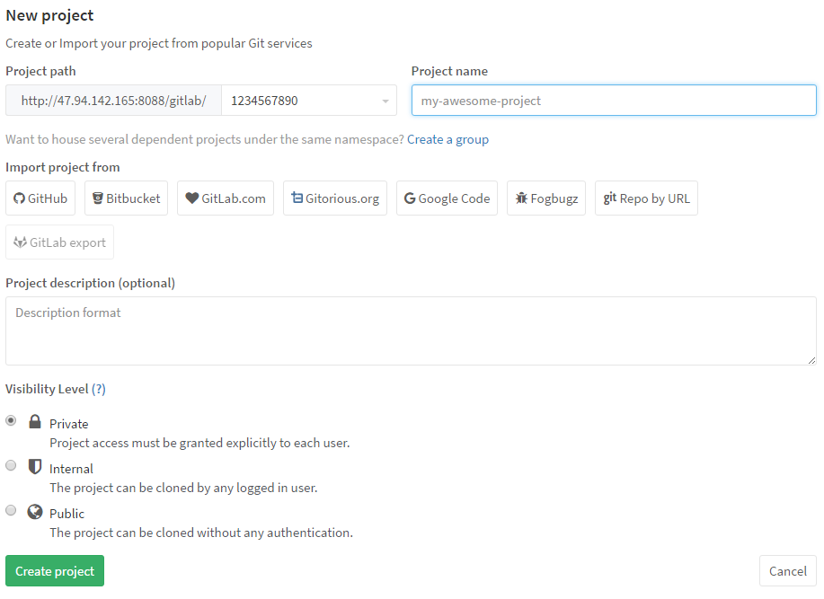
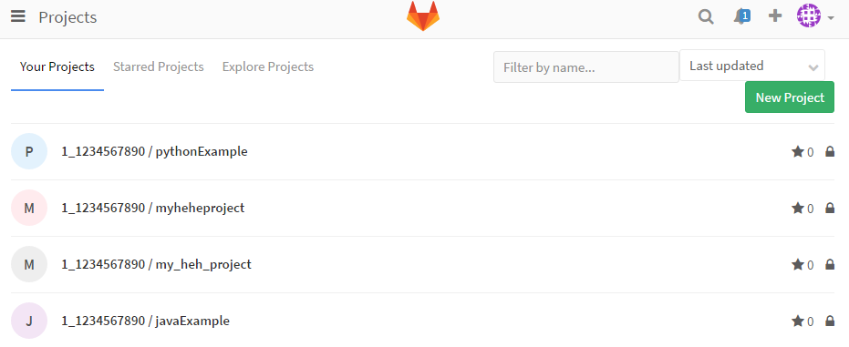
GitLab - Project
Host codebase
Visibility: public, internal, private
Operations
New
Fork
Import/Export
Integration with third-party components

Slide 44
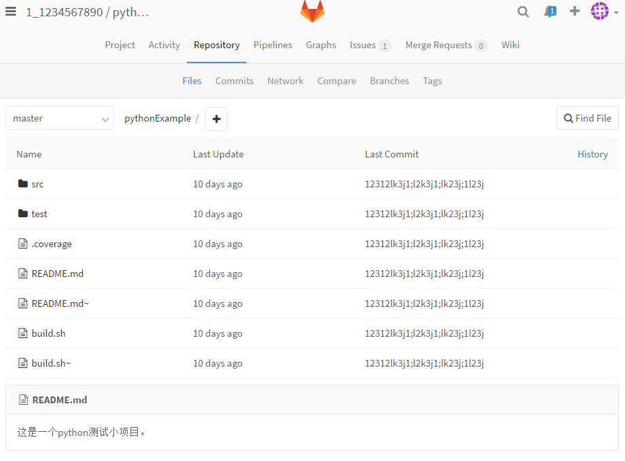
GitLab - Repository
Part of a project, to store codebase
Files
Commits
Network
Compare
Branches
Tags

Slide 45
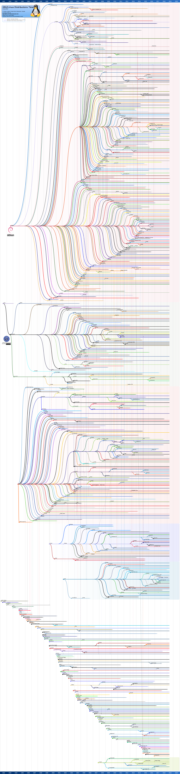
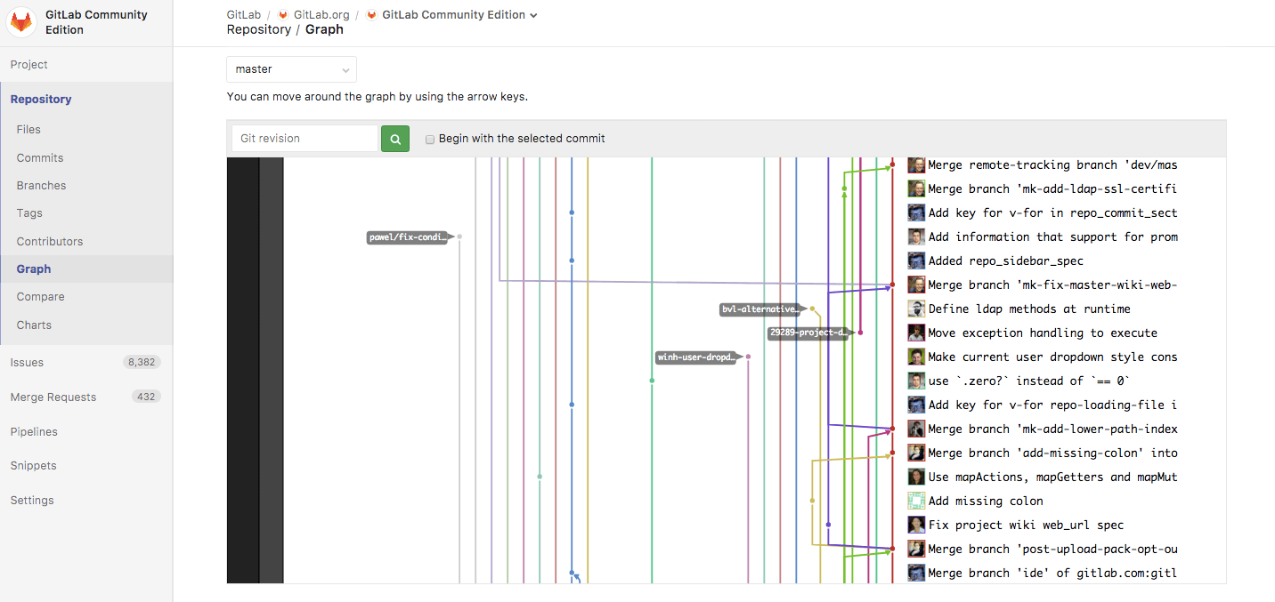
Version Control

Slide 46
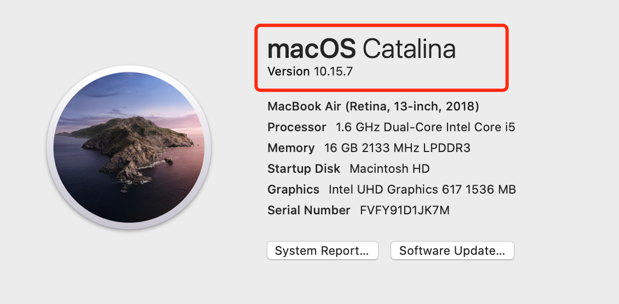
Terminology: Version vs. Revision vs. Release
Many naming schemes exist. A 3-digit scheme is quite common.
A: the release number from customer perspective
The formal distribution of an approved version.
B: the version number from developer perspective
The formal distribution of an approved version.
C: the revision number from developer perspective
Change to a version that corrects only errors in the design/code, but does not affect the documented functionality.
A.B.C
Notes:
组长今天回去之后马上要做的： 大家一定要统一开发环境。版本、库、甚至IDE。 面临重装环境。

Slide 47
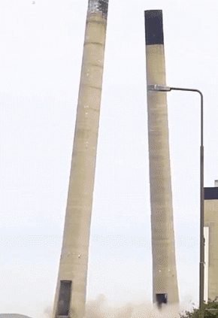
Version Control Concepts
Branch
1.5.1.2.1
1.5.1.2.2
Release
Branch
1.5.1.1
1.5.1.2
Main
Trunk
1.1
1.2
1.3
1.4
1.5
Branch
1.3.1.1
1.3.1.2
1.3.1.3
Branch
1.3.2.1
1.3.2.2
Merge
Notes:
Software that tracks and manages changes to a set of files and resources.
Helps teams to work together on code projects
A shared copy of all code files that all users can access
Keeps current versions of all files, and backup of past versions
Can see what files others have modified and view the changes
Manages conflicts when multiple users modify the same file
➔Not particular to source code, can be used for documents as well
checkout 并行开发： 新功能、修bug; 之后merge
定期进行release

Slide 48
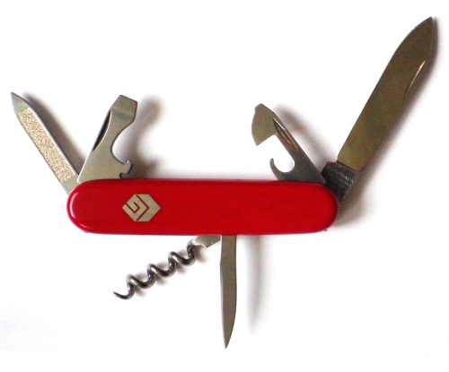
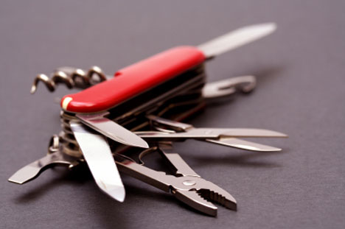
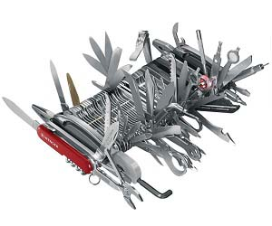
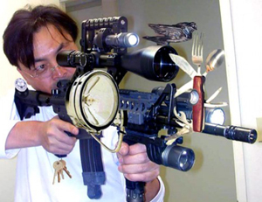
Version Control Tools
SCCS & RCS (70s-80s)
CVS (1986)
Subversion (2001)
Git (2005)
Image © TheSun.au
© 2013 -2017 Armando Fox & David Patterson, all rights reserved Berkeley CS 169 Slides
Notes:
http://git-scm.com/book/en/Getting-Started-About-Version-Control
几十人、上百人同时开发。
集中式：每个版本都提交到中心，性能瓶颈，冲突解决。
从集中式到分布式的变化： 在本地就可以做跟踪和回滚，大大减少提交的数量，对中心服务器的依赖减少。 提升系统工作的性能。
Although Torvalds believes "open source is the only right way to do software", he also has said that he uses the "best tool for the job", even if that includes proprietary software.^{[32]} He was criticized for his use and alleged advocacy of the proprietary BitKeepersoftware for version control in the Linux kernel. Torvalds subsequently wrote a free-software replacement for BitKeeper called Git.
Linus Torvalds has quipped about the name "git", which is British English slang for a stupid or unpleasant person: "I'm an egotistical bastard, and I name all my projects after myself. First Linux, now git.”
饭桶
cvs svn
Speed
Support for non-linear development (thousands of parallel branches)
Fully distributed
Able to handle large projects like Linux efficiently

Slide 49
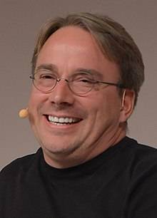
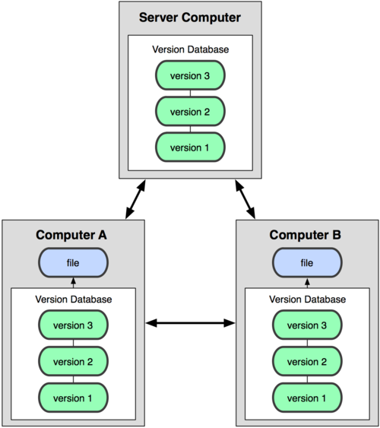
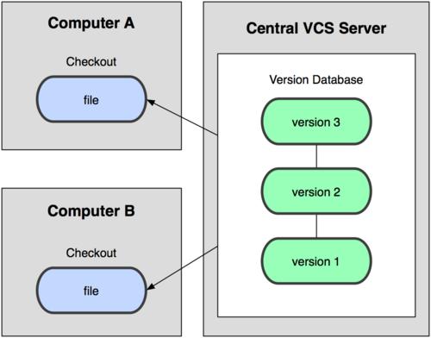
Git uses a distributed model
Centralized Model
Distributed Model
Result: Many operations are local
Came out of Linux development community
Linus Torvalds, 2005
(CVS, Subversion)
Git
Notes:
http://git-scm.com/book/en/Getting-Started-About-Version-Control
几十人、上百人同时开发。
集中式：每个版本都提交到中心，性能瓶颈，冲突解决。
从集中式到分布式的变化： 在本地就可以做跟踪和回滚，大大减少提交的数量，对中心服务器的依赖减少。 提升系统工作的性能。
Although Torvalds believes "open source is the only right way to do software", he also has said that he uses the "best tool for the job", even if that includes proprietary software.^{[32]} He was criticized for his use and alleged advocacy of the proprietary BitKeepersoftware for version control in the Linux kernel. Torvalds subsequently wrote a free-software replacement for BitKeeper called Git.
Linus Torvalds has quipped about the name “git”, which is British English slang for a stupid or unpleasant person: “I‘m an egotistical （狂妄自大） bastard (浑蛋), and I name all my projects after myself. First Linux, now git.”
Git: 蠢货; 饭桶; 讨厌鬼
cvs svn
Speed
Support for non-linear development (thousands of parallel branches)
Fully distributed
Able to handle large projects like Linux efficiently

Slide 50
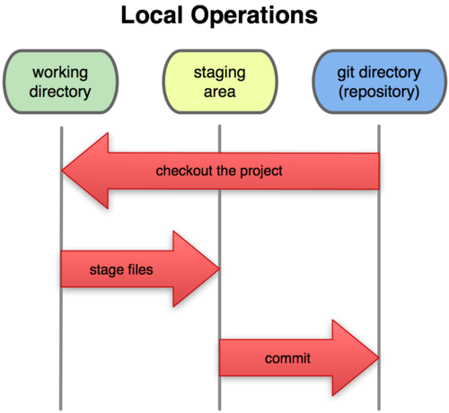
A Local Git project has three areas
Working directory, Unmodified/modified files
Staging area, Staged files
Git directory (repository), Committed files
git add
Commit
A commit message is important to identify what is being changed and, more importantly, why.
Cross-link issues
git commit -m "this is my commit message. Ref #xxx"
Trigger Build/Test
git commit
Notes:
Basic Git workflow:
Modify files in your working directory.
Stage files, adding snapshots of them to your staging area.
Do a commit, which takes the files as they are in the staging area and stores that snapshot permanently to your Git directory.
Notes:
If a particular version of a file is in the git directory, it’s considered committed.
If it’s modified but has been added to the staging area, it is staged.
If it was changed since it was checked out but has not been staged, it is modified.

Slide 51
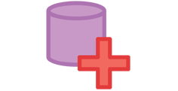



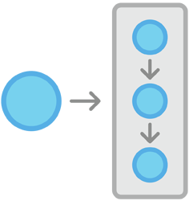
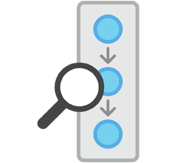

Git Basics
Setting up a Git Repository
Recording Snapshots
Inspecting a Git Repository
Git init
Git add
Git status
Create a new repository and place a project under revision control.
Move changes from the working directory to the staging area, to prepare a snapshot before committing it to the official history.
Display the state of the working directory and the staged snapshot.
Git clone
Create a copy of an existing repository.
Git commit
Git log
Take the staged snapshot and commit it to the project history.
Explore project revision history.
Git config
Set configuration options for Git installation.

Slide 52
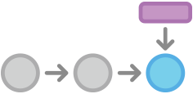


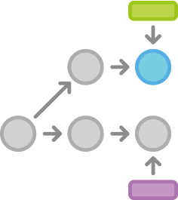

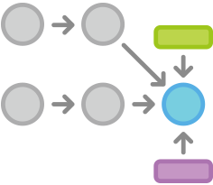
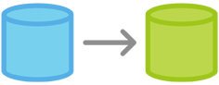
Git Basics
Git Branches
Remote repository
Git branch
Git remote
Create isolated development environments within a single repository.
Git fetch
Git checkout
Check out old commits and file revision, and navigate existing branches.
Git pull
Git merge
Integrate changes from divergent branches.
Git push

Slide 53
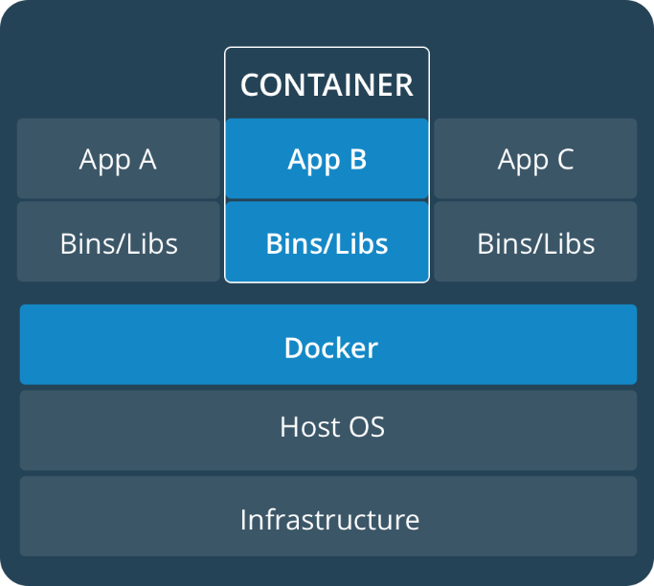
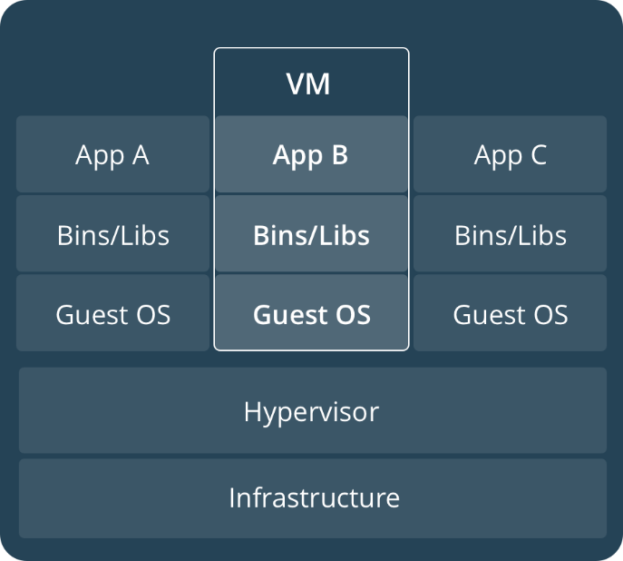
Container - Run
Containers provide a way to package software in a format that can run ISOLATED on a SHARED operating system.
Libraries and settings required to make the software work
Lightweight, self-contained, standard, secured systems
Guarantees that software will always run the same
Container vs. VM
Containers and virtual machines have similar resource isolation and allocation benefits, but function differently because containers virtualize the operating system instead of hardware, containers are more portable and efficient.
Notes:
Docker is a software container
“lightweight VM”, but underlying architecture is fundamentally different
Package software into standardized units for deployment, shipment and deployment.
碎片化不是有App才发生的。 之前就有，更严重
C 到哪儿都得编译，库、版本号不同，
Java: JVM 只需编译一次。 屏蔽了这些。
好的概念被提出来了： 配置管理
软件换个环境还得能跑起来。
配置管理的定义： 跟一个软件软件开发、运维相关的所有环境都管理起来的方法。
管理配置的机制就叫做配置管理。
“An aggregation of hardware, software, or both, that is designated for configuration management and treated as a single entity in the configuration management process. ”
Software configuration items are not only program code segments but all types of documents according to development, e.g.
All types of code files
Drivers for tests
Analysis or design documents
User or developer manuals
System configurations (e.g. version of compiler used)
In some systems, not only software but also hardware configuration items exist!

Slide 54
xUnit - Test
“Each object should be able to test itself”
Junit – The first unit testing framework developed by Erich Gamma and Kent Beck.
Since then unit testing frameworks have been developed for a broad range of computer languages.
xUnit frameworks
A list of test frameworks
http://en.wikipedia.org/wiki/List_of_unit_testing_frameworks

Slide 55
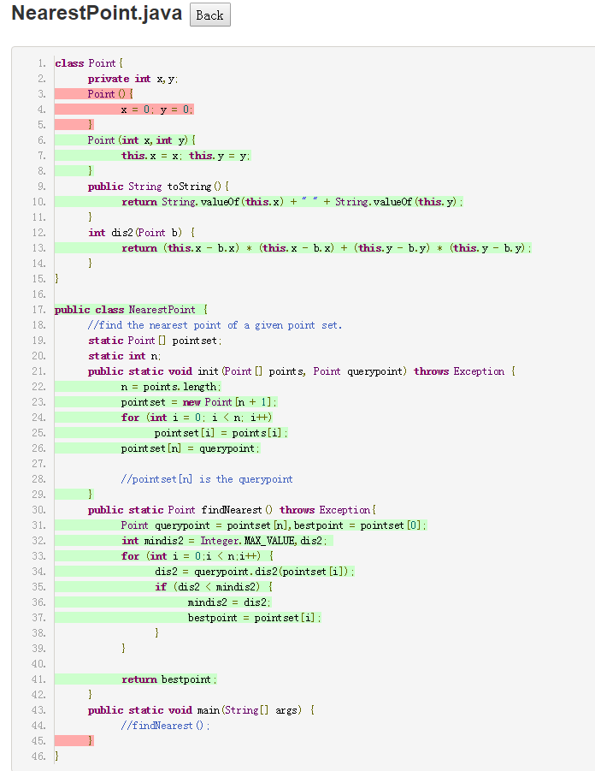
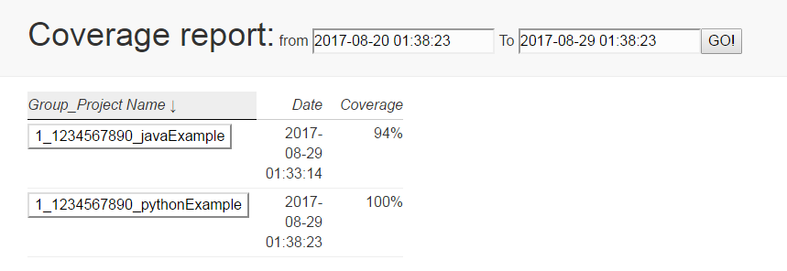
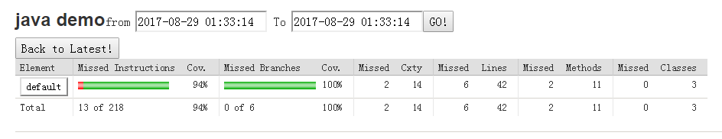


Slide 56


Sonarqube – Quality
Continuous inspection
Automatic review with static analysis of code quality
Health
Duplicated code
Coding standards
Code complexity
Comments
Bugs
Security vulnerabilities
……

Slide 57




Slide 58

Sonarqube
Code Inspection
Technical debt
Sonarlint
IDE plugin
On-the-fly feedback

Slide 59


GitLab – CI/CD
Add .gitlab-ci.yml to the root directory of your repository
Configure a Runner
On every push to the repository, the Runner will
automatically start the pipeline.
Notes:
The configuration of the pipeline
YAML file in the root directory of the repository
Version controlled
Three states: Build, Test, and Deploy
GitLab CI/CD Examples
A collection of repositories with example projects for various languages.
https://docs.gitlab.com/ee/ci/examples/README.html

Slide 60

Thank you!

